Slide 1
Cascading Style Sheets (CSS)
(Basic Edition)

Slide 2
Today we will explore:
Why do we use CSS?
How to add CSS
CSS Selectors
CSS Properties
Inspecting CSS

Slide 3

1. Why do we need CSS?
What is CSS?
Cascading Style Sheets

Slide 4
2.How to add CSS
There are 3 type of ways we can add CSS with HTML.
They are: Inline, Internal and External
Inline
Internal
External
<tag style=“css” />
<style>css</style>
<link href=“style.css”/>

Slide 5

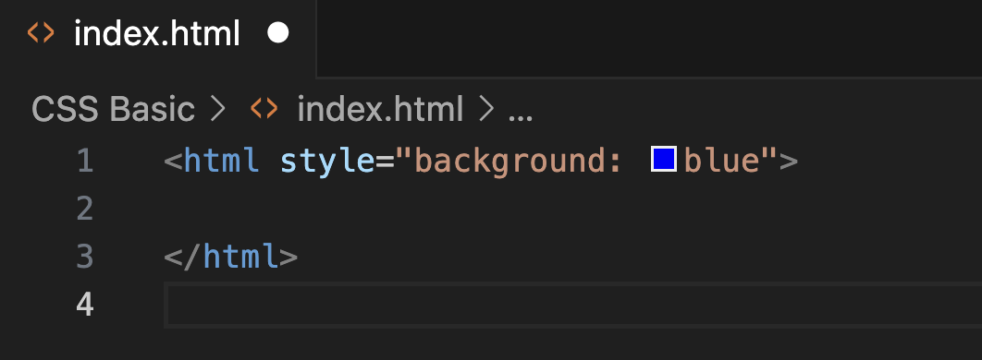
2.How to add CSS
Inline

Slide 6

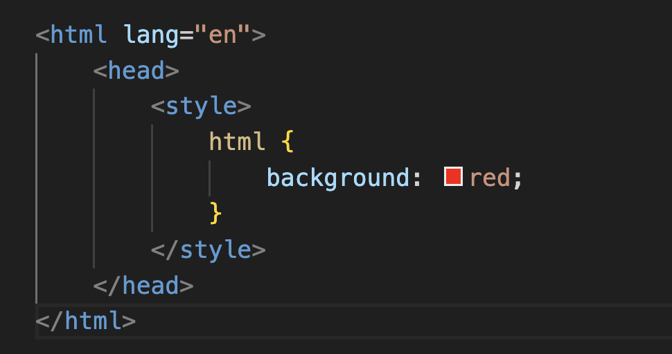
2.How to add CSS
Internal

Slide 7
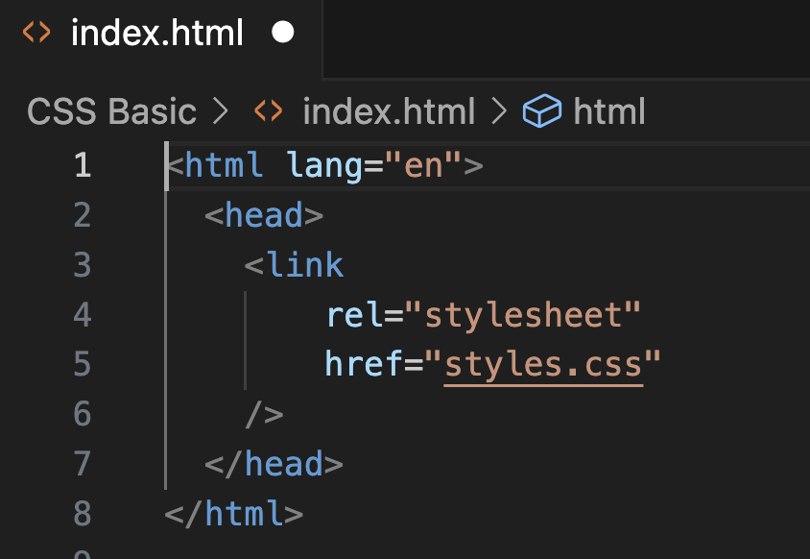
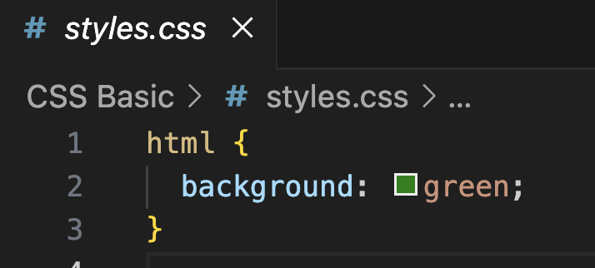
2.How to add CSS
External
(**prefered choice)
styles.css
index.html

Slide 8

2.How to add CSS
External

Slide 9









2.How to add CSS
Inline
Internal
External

Slide 10
2.How to add CSS
Exercise Instructions
Download the zip folder
Extract the folder in your computer
Open it VSCode

Slide 11
2.How to add CSS
Question 1:
What is the correct syntax for adding inline CSS to an HTML element?
<element style=“CSS code”>
<element css=“CSS code”>
<element inline=“CSS code”>
<element addcss=“CSS code”>

Slide 12


3. CSS Selectors
Choosing Where to Apply CSS
Element Selector
h1 {
color: blue
}
All h1 element will be selected.

Slide 13






3. CSS Selectors
Choosing Where to Apply CSS
Element Selector
p {
color: blue
}
All paragraph element will be selected.

Slide 14
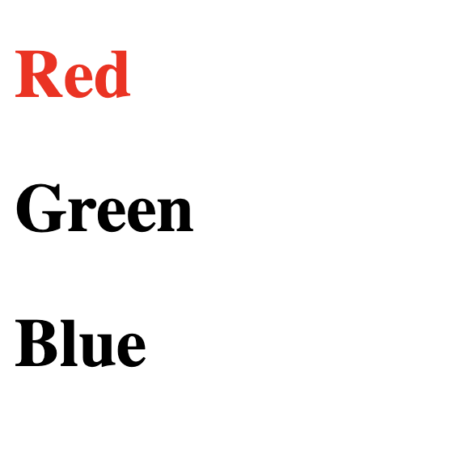
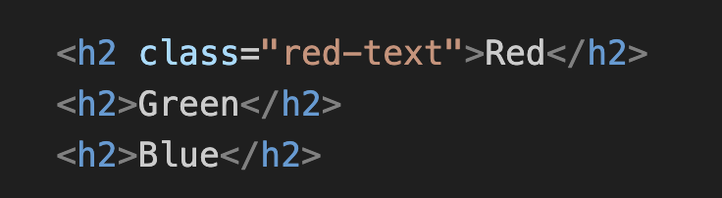
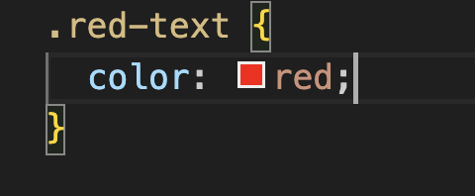
3. CSS Selectors
Class Selector
index.html
styles.css

Slide 15
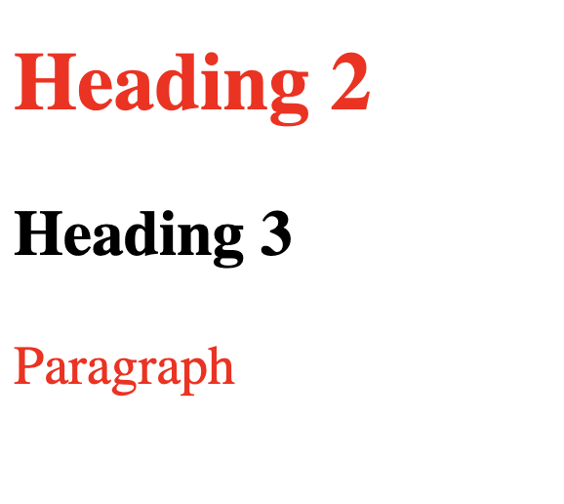
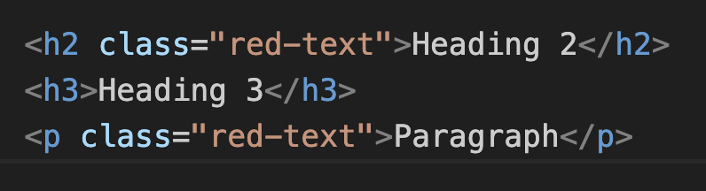
3. CSS Selectors
Class Selector
index.html
styles.css

Slide 16
3. CSS Selectors
Id Selector
#main {
color: blue
}

Slide 17
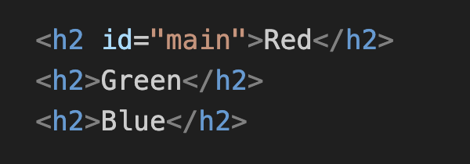
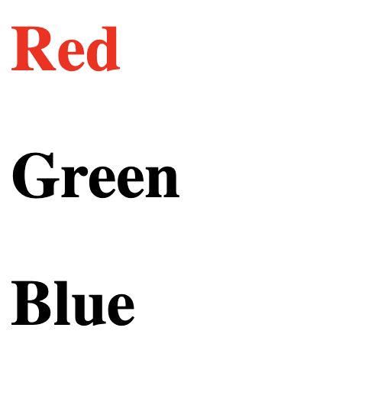
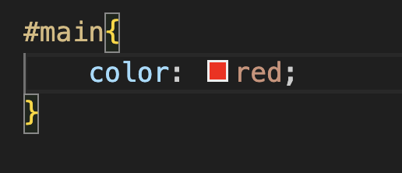
3. CSS Selectors
Id Selector
index.html
styles.css

Slide 18




3. CSS Selectors
Choosing Where to Apply CSS
Attribute Selector
p[movable] {
color: red
}

Slide 19
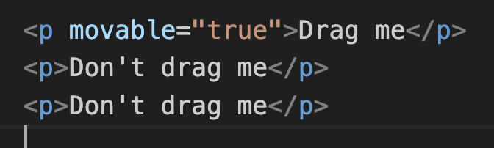
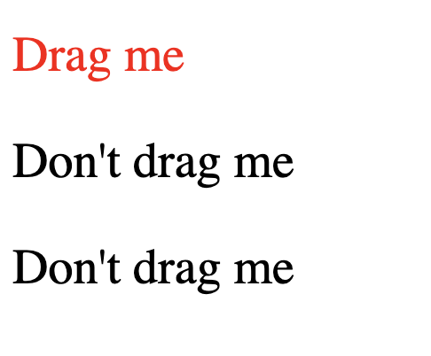
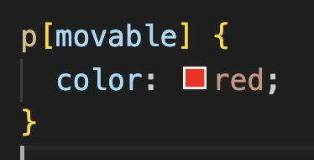
3. CSS Selectors
Attribute Selector
index.html
styles.css

Slide 20
3. CSS Selectors
Choosing Where to Apply CSS
Universal Selector
* {
color: red
}

Slide 21
3. CSS Selectors
Try with exercise:

Slide 22
4. CSS Properties
Adding color to our websites
4.1 Color Properties
html {
background-color: red
}
h1 {
color: blue
}

Slide 23
4. CSS Properties
Adding color to our websites
4.2 Font Properties
h1 {
color: blue
font-weight: bold
font-size: 20px
font-family: sans-serif
}

Slide 24
4. CSS Properties
Adding color to our websites
Font Size
h1 {
font-size: 20px
}

Slide 25
4. CSS Properties
Font Size
1px
1pt
1em
1rem
1/96th inch
1/72nd inch
100% of parent
100% of root

Slide 26
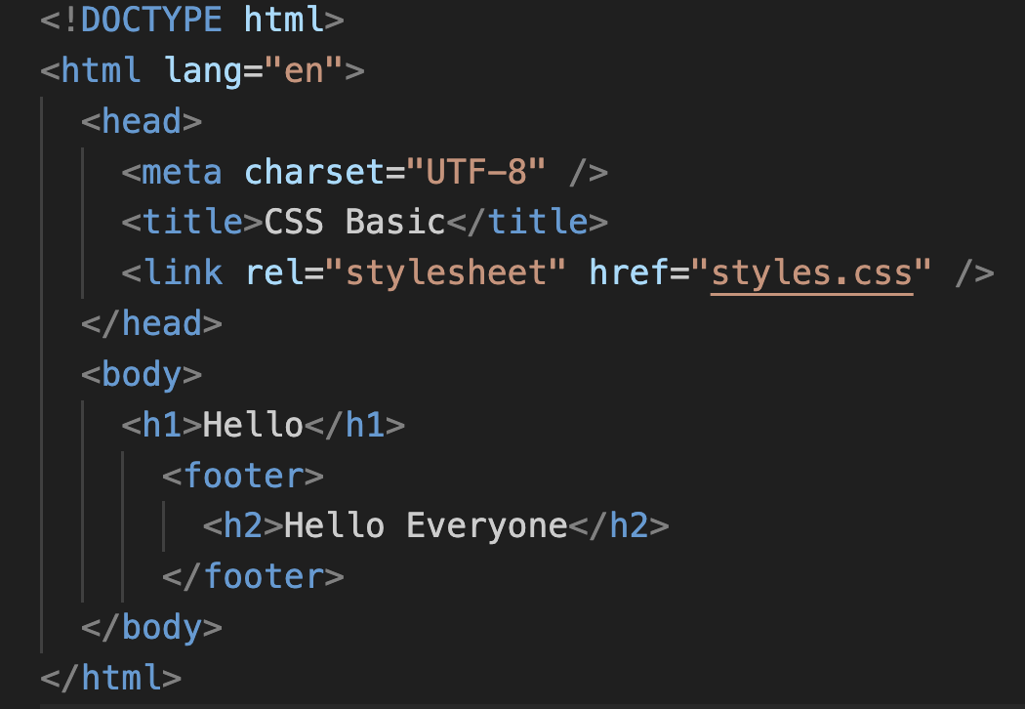


4. CSS Properties
Font Size
1em
1rem
100% of parent
100% of root

Slide 27
4. CSS Properties
Font Size
Exercise Instructions
Download the zip folder
Extract the folder in your computer
Open it VSCode
Head over to font-size.html

Slide 28
4. CSS Properties
Font Weight
h1 {
font-weight: bold
}

Slide 29
4. CSS Properties
Font Weight
normal
bold
Lighter
bolder
number
Keywords
Relative to Parent
100-900

Slide 30









4. CSS Properties
Font Family
h1{
font-family: Helvetica, sans-serif
}
h2 {
font-family: ”Times New Roman”, serif
}

Slide 31






4. CSS Properties
Text Align
h1 {
text-align: center
}

Slide 32
5. Inspecting CSS

